Slide 1
BATTLE OF THE NEIGHBORHOODS
Manhattan vs Toronto
By Asavari Paluskar

Slide 2
Battle of the Neighborhoods
Contents:
Introduction
Data
Methodology
Results
Discussion
Conclusion
2

Slide 3
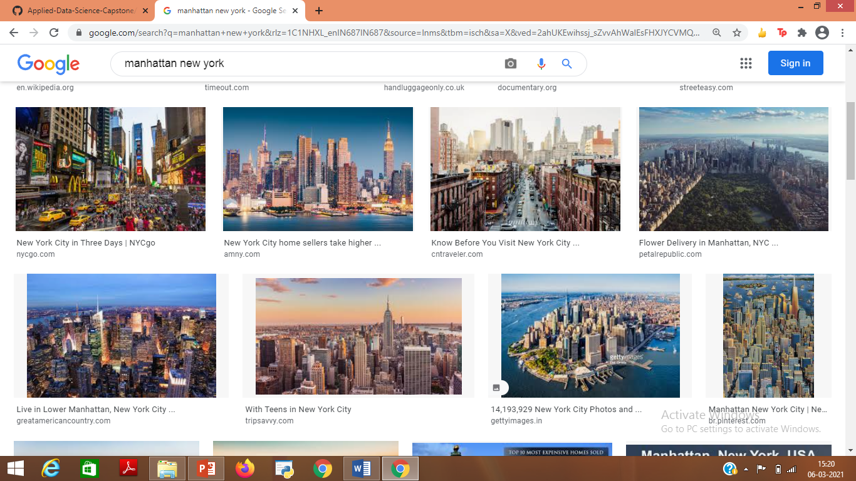
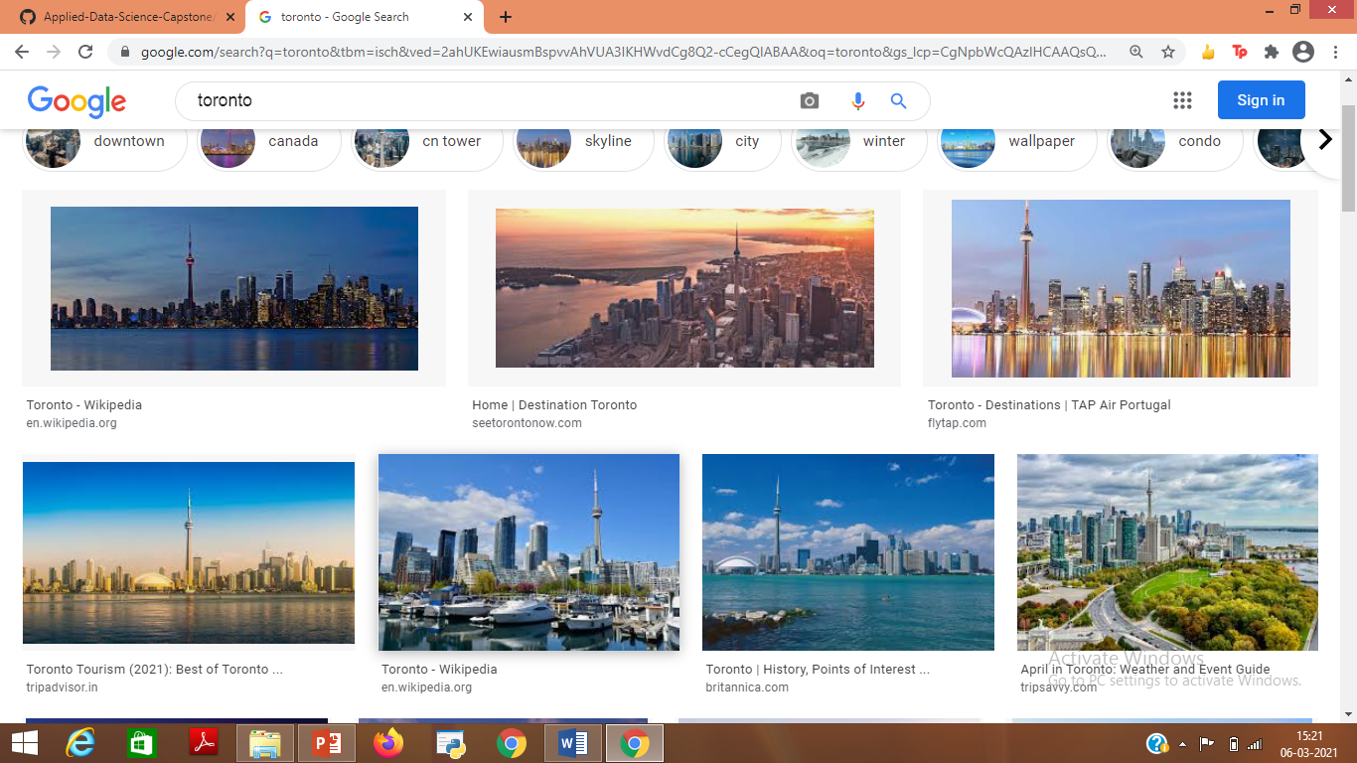
1. Introduction :
Manhattan
Objective:
- Analysing and exploring the data of Manhattan and Toronto to find the the most favoured type of activity by the customers and find the venue which has the maximum number of visitors (customer foot-fall).
- Select the best type of business venture in each of the geographical regions.
Client: ABC & Co.
Success Criteria: Finding the type of business with maximum customer foot-fall in Manhattan and Toronto.
Toronto
3
By Asavari Paluskar

Slide 4
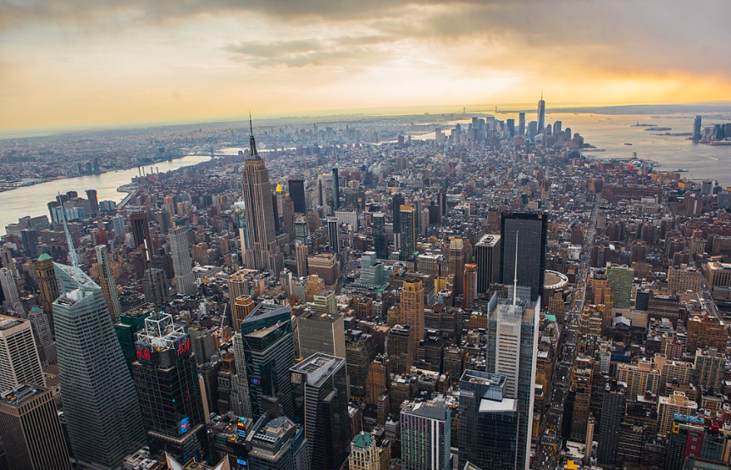
Neighborhoods Analysed:
New York:
Most populous city in the United States
Home to a wide variety of businesses and financial capital of the United States
Major centre for banking and finance, retailing, world trade, transportation, tourism, real estate, new media, traditional media, advertising, legal services, accountancy, insurance, theatre, fashion, and the arts .
Wide customer base and ever increasing population. High competition.
Five boroughs: Brooklyn, Queens, Manhattan, Bronx and Staten Island.
(B) Manhattan:
Urban core of New York
City’s economic and administrative centre, cultural identifier and historical birthplace.
Hosts the United Nations Headquarters.
3
By Asavari Paluskar

Slide 5
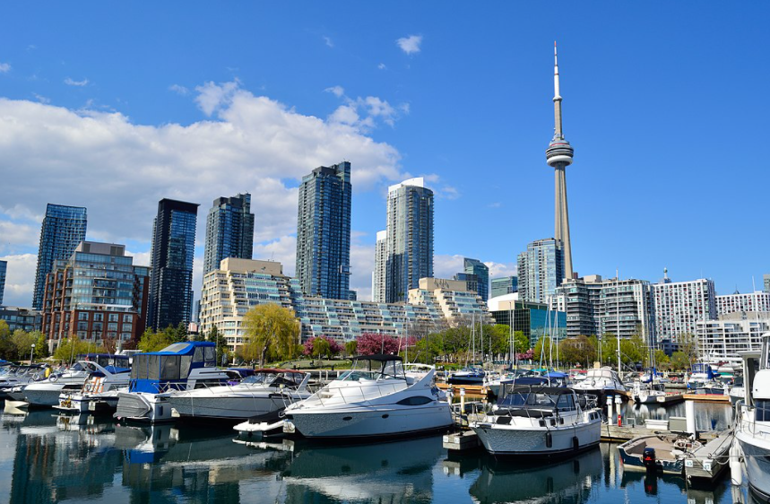
Neighborhoods Analysed:
(C) Toronto:
Most populous city in Canada
International centre of business, finance, arts, and culture
Recognized as one of the most multicultural and cosmopolitan cities in the world
Diverse population – important destination for immigrants.
Prominent centre for music, theatre, motion picture production, and television production.
Ever increasing population – ideal for starting a new business.
3
By Asavari Paluskar

Slide 6
Problem Description:
Starting a new business venture in Manhattan or Toronto can be very risky.
Ever increasing competition and high cost of establishment.
Various types of businesses operational in both geographical areas like restaurants offering various cuisines, cafes, coffee shops, amusement parks, gyms, bars, bakeries etc.
The demand structure in Manhattan and Toronto is very different.
Necessary for an aspiring entrepreneur to study the customer base thoroughly and select an area of business that is most favoured by the target audience
We need to analyse data of both geographical regions separately, visualize it and find the most profitable business venture in each geographical area, in terms of customer foot-fall.
3
By Asavari Paluskar

Slide 7
2. Data:
(A) Libraries and dependancies used:
Numpy, Pandas, json, geopy, matplotlib, kmeans clustering, folium and BeautifulSoup
Manhattan: Data for New York is much bigger than the data for Toronto, hence, New York data is sliced and only the data pertaining to Manhattan is selected for further analysis, for ease of comparability with Toronto data.
(B) Datasets for Geographical Regions Analysed:
New York: "https://cf-courses-data.s3.us.cloud-object-storage.appdomain.cloud/IBMDeveloperSkillsNetwork-DS0701EN-SkillsNetwork/labs/newyork_data.json”
Toronto: Data not readily available.
Webpage: https://en.wikipedia.org/wiki/List_of_postal_codes_of_Canada:_M
Data extracted using BeautifulSoup.
3
By Asavari Paluskar

Slide 8
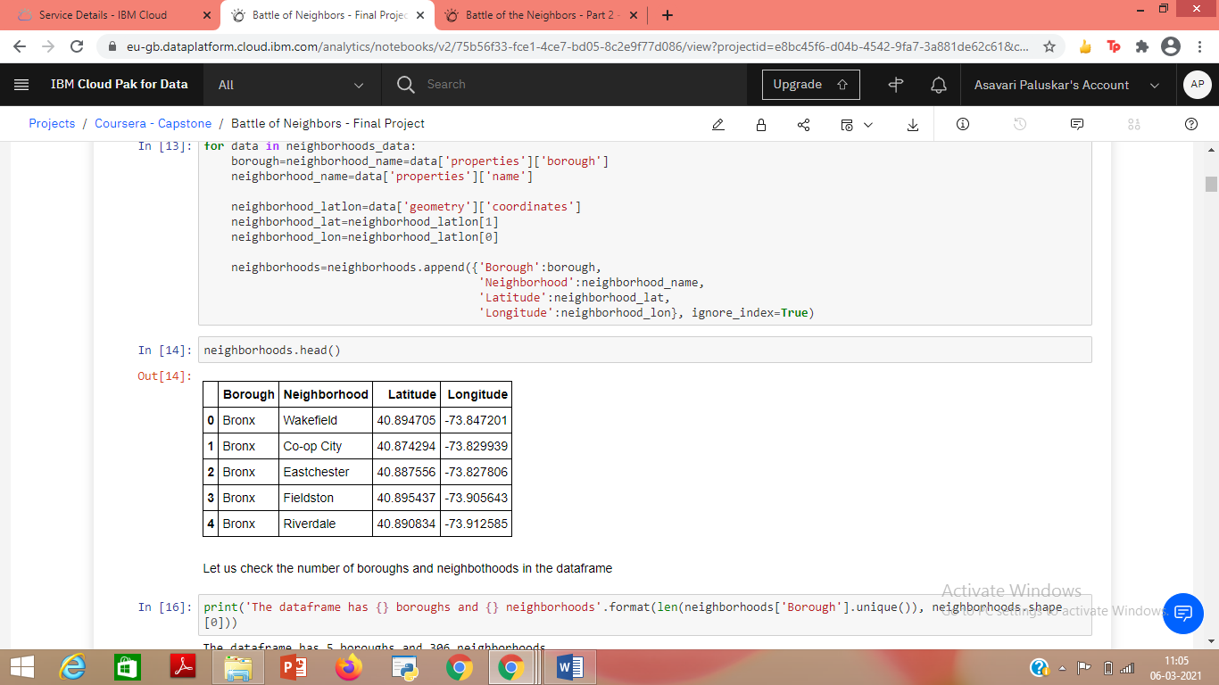
3. Methodology:
Exploratory Data Analysis:
New York:
Load data from newyork_data.json file.
Transform it in a pandas dataframe and loop the data to fill the dataframe containing geographical co-ordinates of neighborhoods in NYC.
Data used to get details of venues in NYC from Foursquare API.
Dataframe for New York
3
By Asavari Paluskar

Slide 9
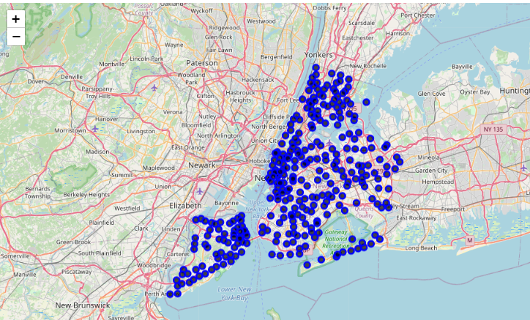
Exploratory Data Analysis (continued):
New York (continued):
Geopy and Folium used to get the geographic co-ordinates and create a map of New York with all the neighborhoods superimposed on top.
Foursquare API is used to get details of venues in New York.
New York dataset much larger than Toronto dataset, so the dataset is sliced to select data for only Manhattan, which is comparable to Toronto in terms of size.
Map of New York using Folium
3
By Asavari Paluskar

Slide 10
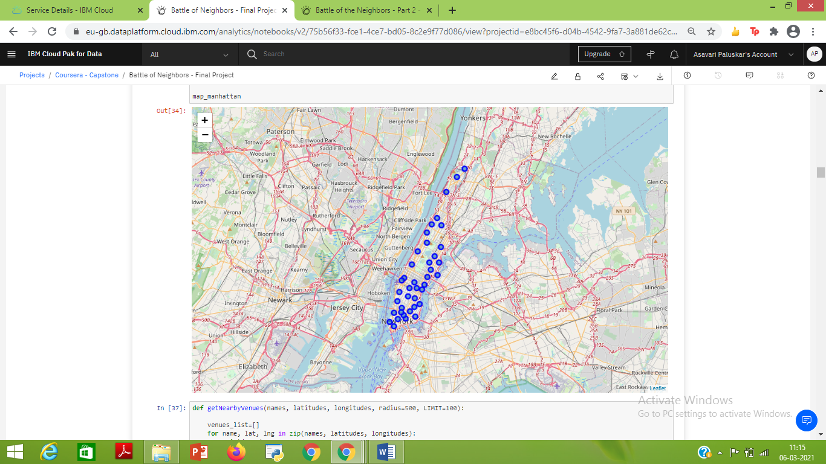
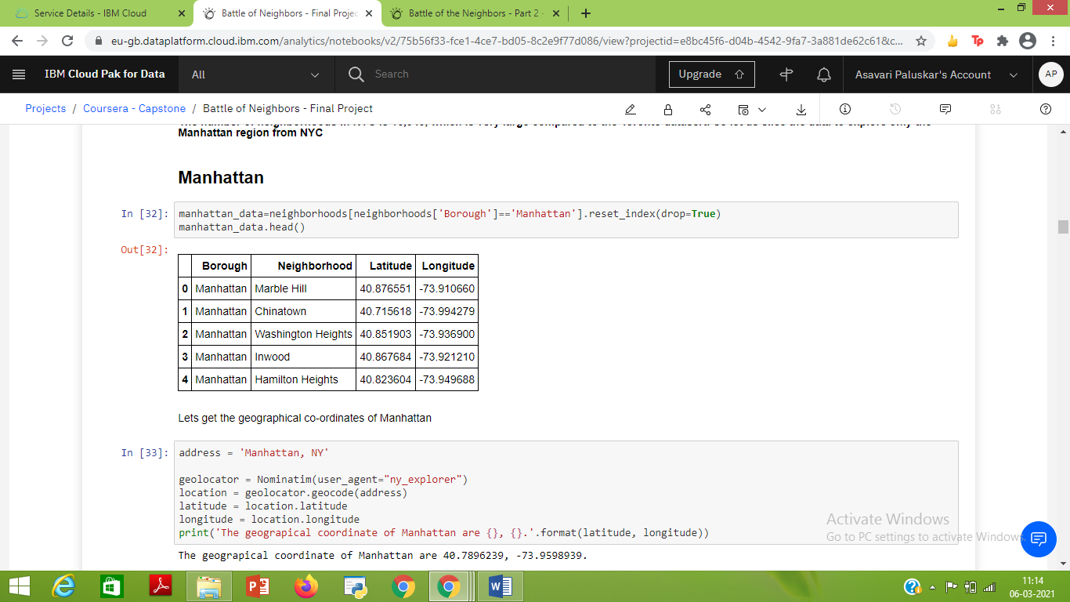
Exploratory Data Analysis (continued):
(B) Manhattan:
New York dataset is sliced to select data for Manhattan.
Get geographical co-ordinates using geopy and create a map using Folium
Map of Manhattan using Folium
Dataset for Manhattan
3
By Asavari Paluskar

Slide 11
Exploratory Data Analysis (continued):
(B) Manhattan (continued):
Foursquare API used to get details of venues in each neighbourhood and their co-ordinates.
Onehot encoding used to transform the dataset based on venues and neighborhoods.
Data grouped based on neighborhoods by taking mean of the frequency of occurrence of each.
Data grouped based on the 10 most commonly visited venues by customers in different neighborhoods and transformed into a pandas dataframe.
(dataframe on next slide)
3
By Asavari Paluskar

Slide 12
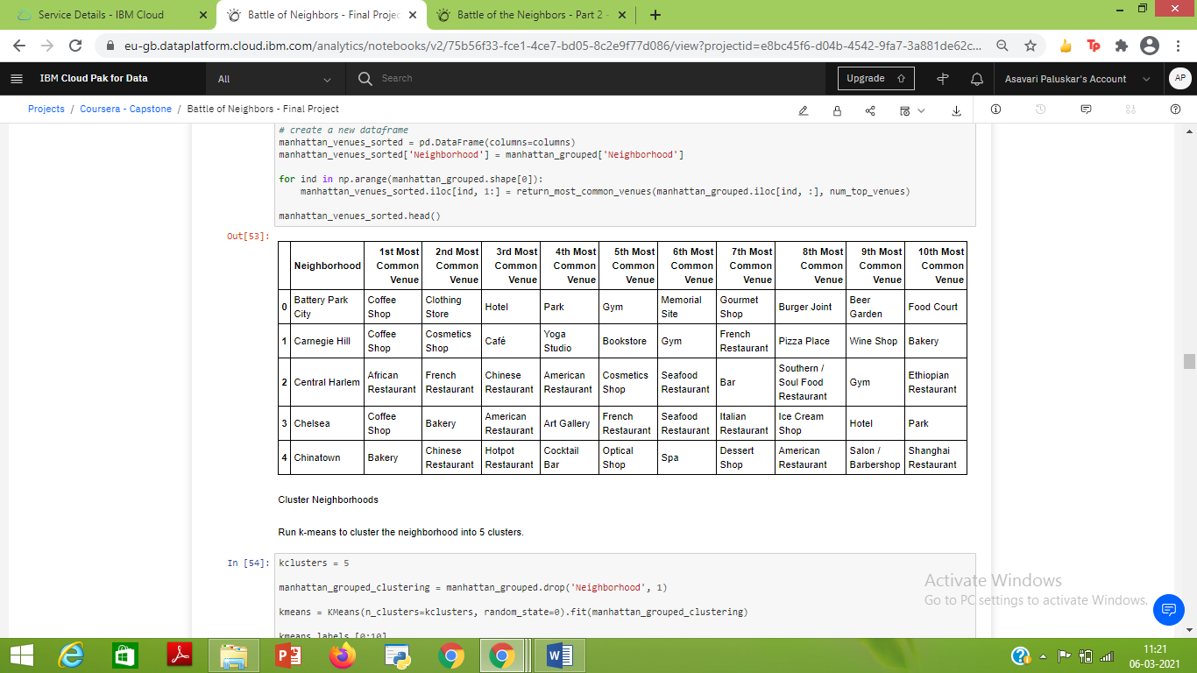
Exploratory Data Analysis (continued):
(B) Manhattan (continued): Dataset of 10 most commonly visited venues by customers in different neighborhoods transformed into a pandas dataframe.
3
By Asavari Paluskar

Slide 13
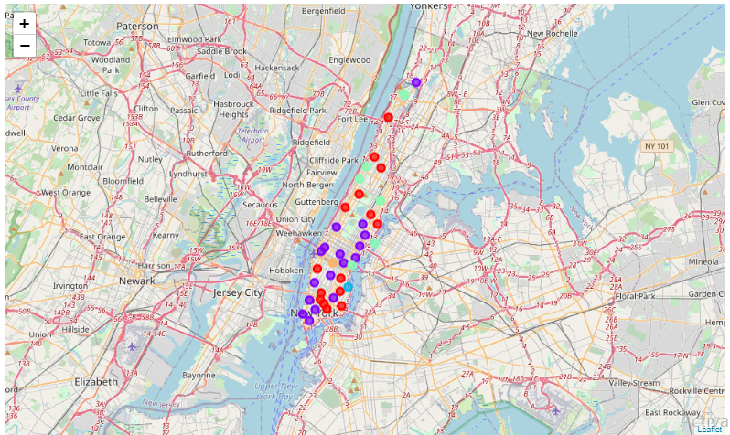
Exploratory Data Analysis (continued):
(B) Manhattan (continued):
Kmeans clustering used to divide the data in five clusters.
Dataframe created containing details of all the neighborhoods, clusters and the top 10 venues for each neighbourhood.
Cluster data visualised using Folium. Each cluster marked in a different colour on the map
Map of Manhattan with Clusters using Folium
3
By Asavari Paluskar

Slide 14
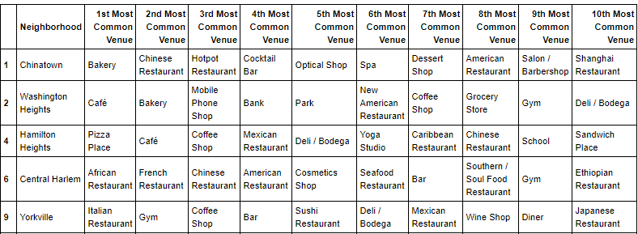
Exploratory Data Analysis (continued):
(B) Manhattan (continued): Each cluster examined separately.
Extract of cluster one for example:
3
By Asavari Paluskar

Slide 15
Exploratory Data Analysis (continued):
(C) Toronto:
Toronto data is not easily available. So the following webpage is used: https://en.wikipedia.org/wiki/List_of_postal_codes_of_Canada:_M
BeautifulSoup used to get data from the webpage.
Data transformed into a pandas dataframe and data looped in to fill the dataframe.
Geocoder used to get the geographic co-ordinates for each postal code.
The two tables are then merged to create one table containing details of neighborhoods and their co-ordinates.
The dataset contains details for all the boroughs, so it is sliced to select data for Toronto. (dataset in next slide)
3
By Asavari Paluskar

Slide 16
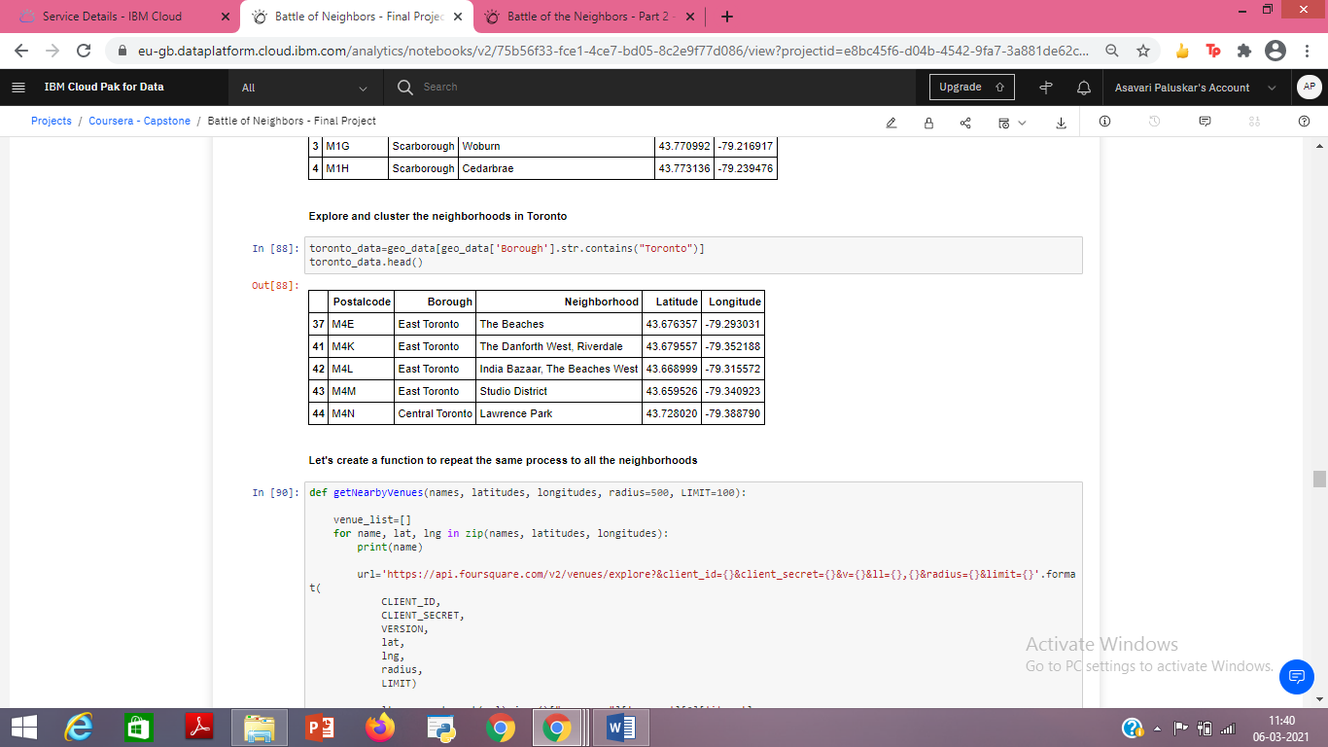
Exploratory Data Analysis (continued):
(C) Toronto (continued):
Foursquare API used to get details of venues in each neighbourhood and their co-ordinates.
Onehot encoding used to transform the dataset based on venues and neighborhoods.
Data grouped based on neighborhoods by taking mean of the frequency of occurrence of each.
Extract of dataset for Toronto
3
By Asavari Paluskar

Slide 17
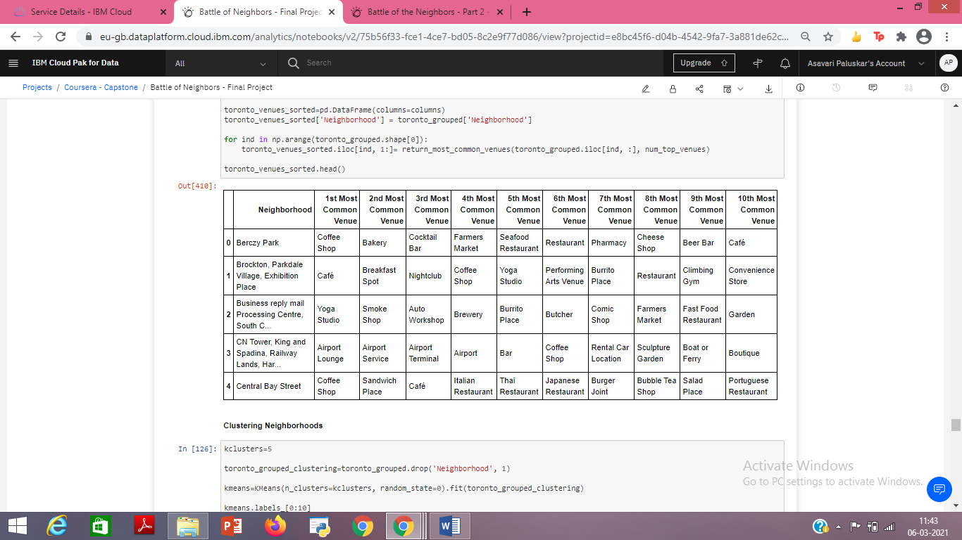
Exploratory Data Analysis (continued):
(C) Toronto (continued):
Data grouped based on the 10 most commonly visited venues by customers in different neighborhoods and transformed into a pandas dataframe.
3
By Asavari Paluskar

Slide 18
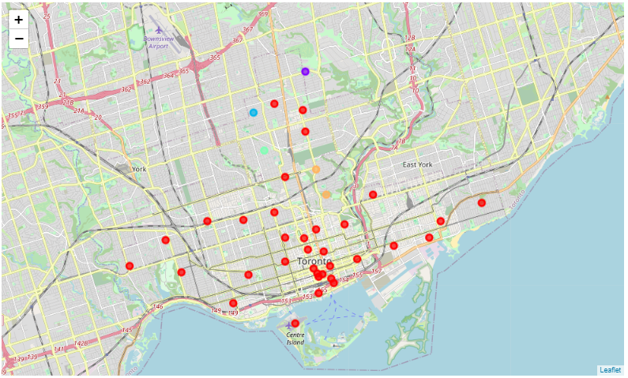
Exploratory Data Analysis (continued):
(C) Toronto (continued):
Kmeans clustering used to divide the data in five clusters.
Dataframe created containing details of all the neighborhoods, clusters and the top 10 venues for each neighbourhood.
Cluster data visualised using Folium. Each cluster marked in a different colour on the map
Map of Toronto with Clusters using Folium
3
By Asavari Paluskar

Slide 19
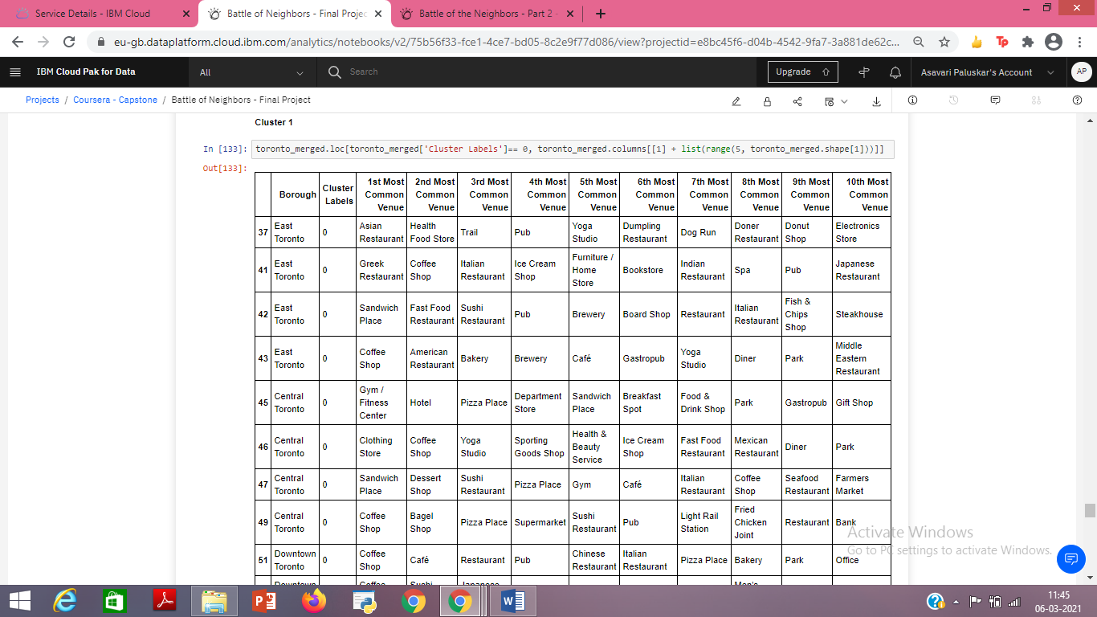
Exploratory Data Analysis (continued):
(C) Toronto (continued): Each cluster examined separately.
Extract of cluster one for example:
3
By Asavari Paluskar

Slide 20
Exploratory Data Analysis (continued):
(D) Analysing Manhattan and Toronto based on venues:
Analysing both geographical regions to find the most favoured activity by the target audience in these regions.
Pie charts used for data visualisation*.
Using the base data for neighborhoods and venues that was used earlier, a pandas dataframe containing details of the most common venues in each neighbourhood in Manhattan and Toronto is created. (dataframes in next slide)
* Note: the preferred mode for visualising and presenting the results was wordcloud, but as there was some error while downloading the package, we had to use pie chart.
3
By Asavari Paluskar

Slide 21
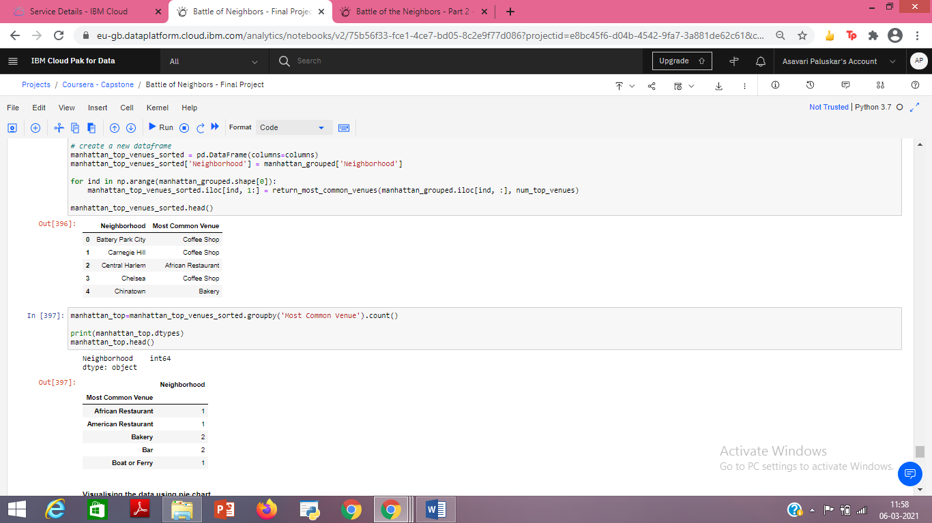
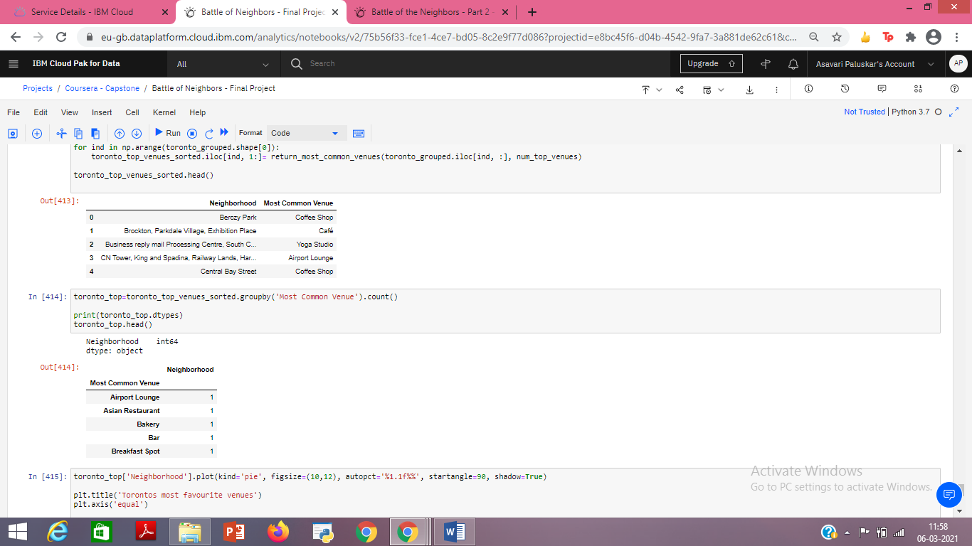
Exploratory Data Analysis (continued):
(D) Analysing Manhattan and Toronto based on venues (continued):
Extract of dataframes created:
Manhattan
Toronto
3
By Asavari Paluskar

Slide 22
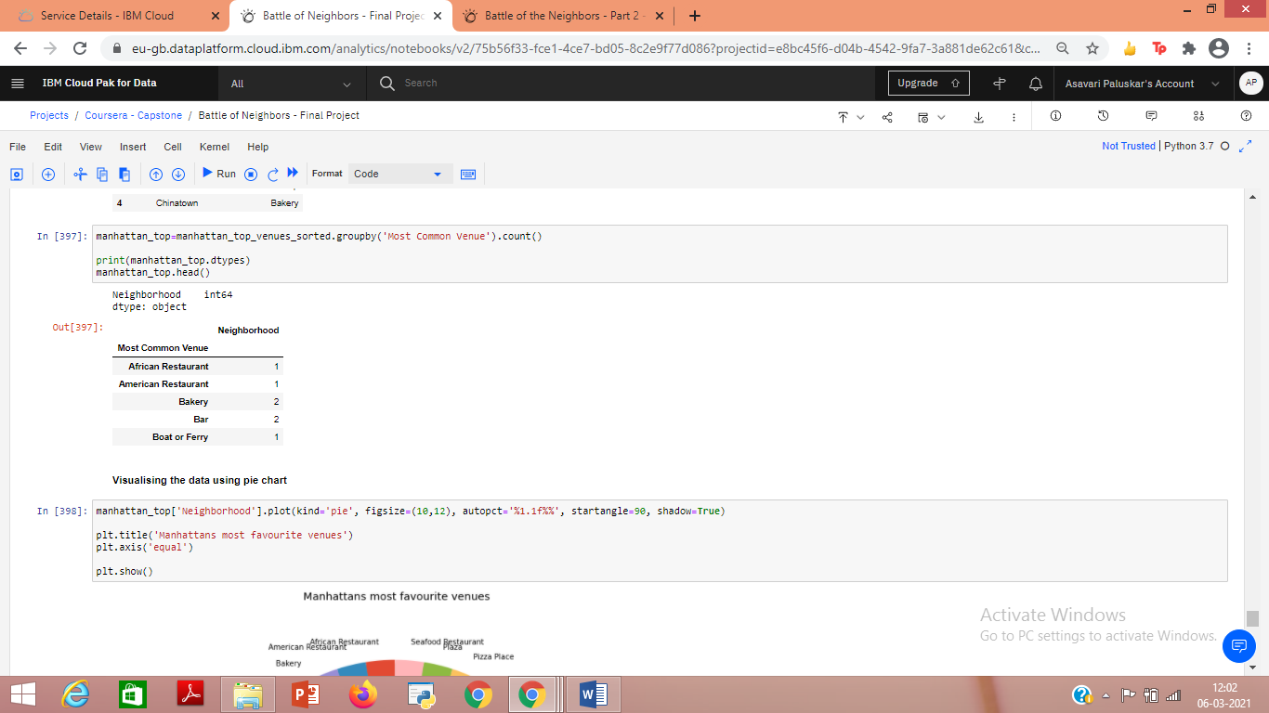
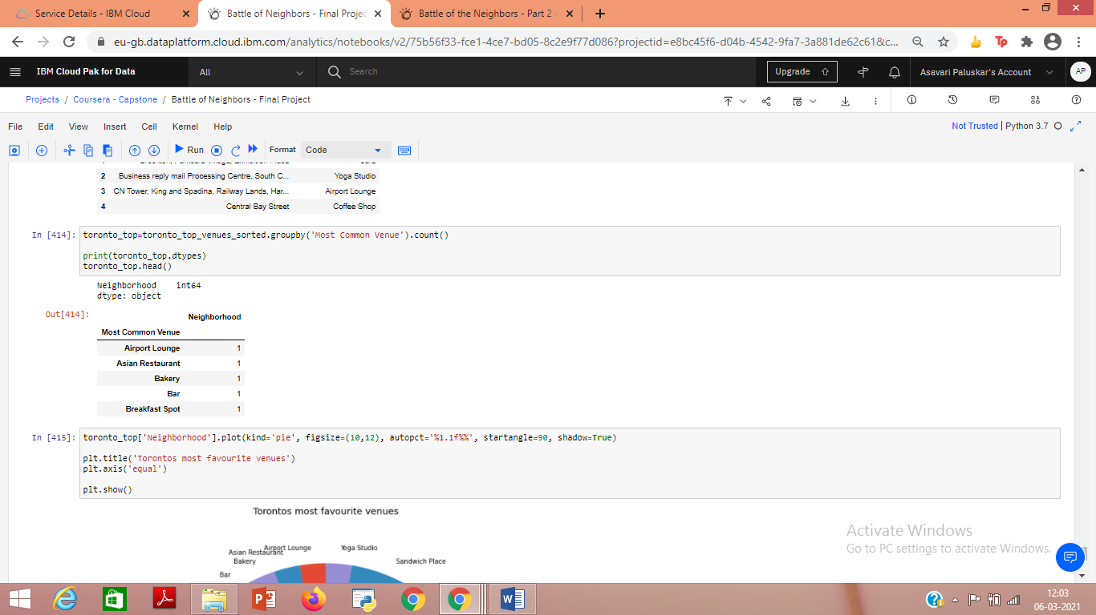
Exploratory Data Analysis (continued):
(D) Analysing Manhattan and Toronto based on venues (continued):
Proceed by taking a count of the neighborhoods for each of the ‘Most Common Venues’ for Manhattan and Toronto. This would help in creating pie charts. (Extract of data:)
Matplotlib and ggplot are used to create pie-charts
Manhattan
Toronto
3
By Asavari Paluskar

Slide 23
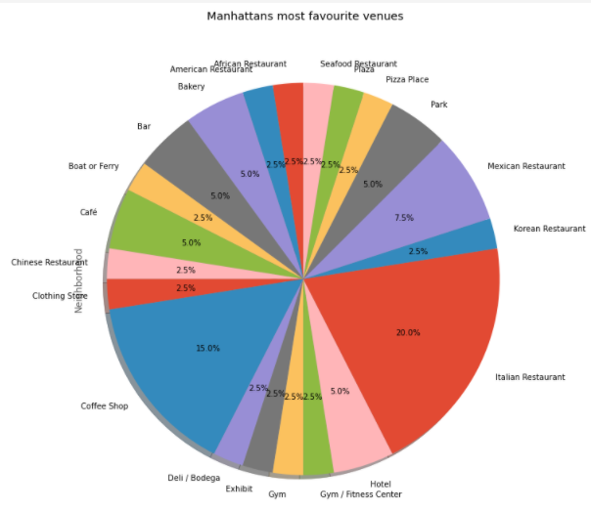
Exploratory Data Analysis (continued):
(D) Analysing Manhattan and Toronto based on venues (continued):
Pie-chart for Manhattan:
3
By Asavari Paluskar

Slide 24
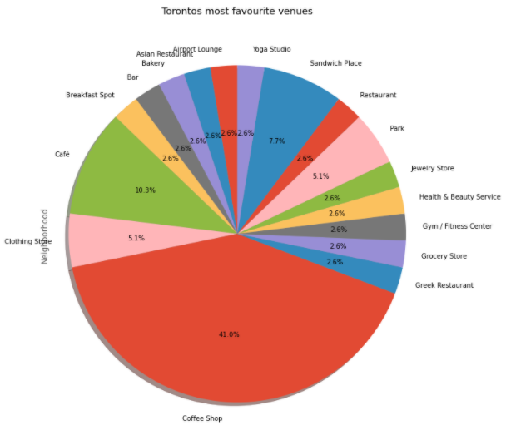
Exploratory Data Analysis (continued):
(D) Analysing Manhattan and Toronto based on venues (continued):
Pie-chart for Toronto:
3
By Asavari Paluskar

Slide 25
4. Results:
(a) Based on the analysis, we see that both Manhattan and Toronto are:
Similar in terms of being multi-cultural and cosmopolitan cities
Major centres for various businesses
Provide a large customer base
Attract new businesses and are subject to every increasing competition in the business environment.
(Analysis of Manhattan and Toronto on next slide)
(b) An aspiring entrepreneur needs to carefully analyse both the geographical regions before deciding on the type of business venture.
(c) The type of venue that has the most customer footfall could be considered as an ideal type of business for an aspiring entrepreneur, in order to ensure profit.
3
By Asavari Paluskar

Slide 26
4. Results (continued):
Manhattan:
Based on the pie-chart, we see that the most commonly visited venues and their share in customer foot-fall are:
(a) Italian Restaurants – 20%
(b) Coffee Shops – 15%
(c) Mexican Restaurants – 7.5%
All three put together account for about 42.5% of the total customer foot-fall.
Following them are Parks, Bakeries, Bars, Cafes and Hotels, each with a share of 5%.
Toronto:
Based on the pie-chart, we see that the most commonly visited venues and their share in customer foot-fall are:
(a) Coffee Shops – 41%
(b) Cafes – 10.3%
Both put together account for about 51.3% of the total customer foot-fall, which is more than half the market size.
Following them are Sandwich shops(7.3%), Clothing Stores (5%) and Parks (5%).
3
By Asavari Paluskar

Slide 27
5. Discussion:
The analysis is based on various sources of information and assumptions:
The venue information extracted using Foursquare API, which may not account for all the customers in the geographical regions.
Manhattan region from New York is used for the purpose of analysis and to make it comparable to Toronto data. However, the Manhattan data may not be an exact representation for the entire New York dataset. Customer preferences may differ depending on the geographical regions within New York.
High customer footfall has been assumed to be the representative of high sales and high profit, however, it may not always be so.
Information regarding the profit margins and initial capital expenditure for each of the businesses/venues analysed could further help in deciding the most profitable type of business.
4
By Asavari Paluskar

Slide 28
6. Conclusion:
Manhattan and Toronto are very different in terms of activities that are most favoured by the customers. Hence, establishing the same type of business in both the regions may not yield the same level of returns.
In Manhattan, an aspiring entrepreneur could expect a favourable response from the target customers if they were to open an Italian Restaurant or a Coffee Shop or a Mexican Restaurant.
In Toronto, on the other hand, they could expect a favourable response from the target customers if they were to open a Coffee Shop or a Café.
Note:The analysis is based on limited data and market segment information. Further information about customer preferences, profit margins and capital investments in various businesses in both the geographical regions could help refine the results.
By Asavari Paluskar

Slide 29
THANK YOU !
By Asavari Paluskar

